Slide 1
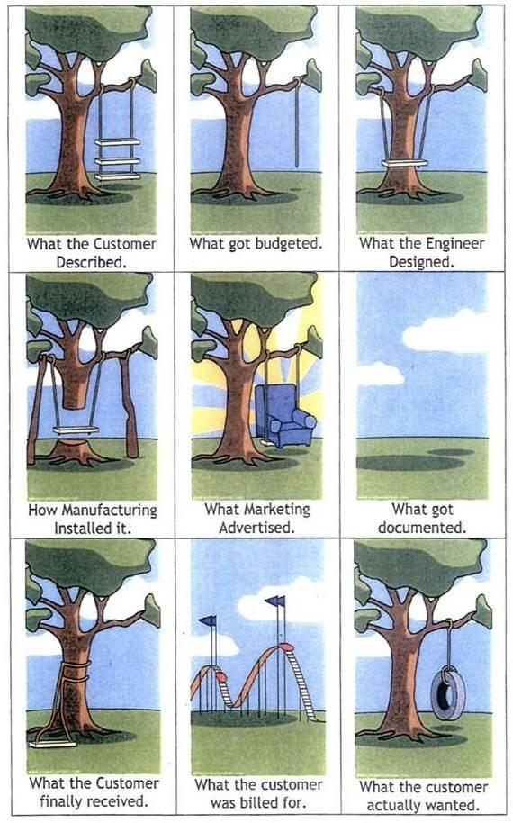
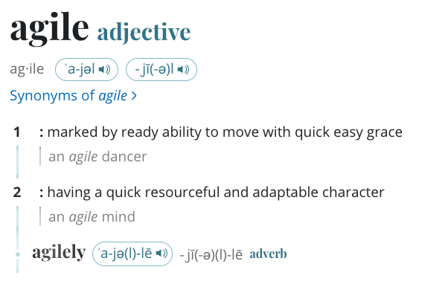
Problem Solving
and Agile Software Development
teAch Bedeus LLC is licensed under a Creative Commons Attribution-NonCommercial-ShareAlike 3.0 Unported License

Slide 2
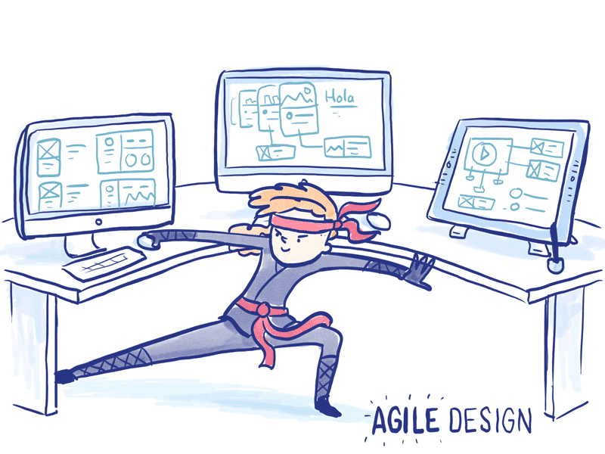
Agile
We will approach developing software with an agile mindset.
This is to guide you on how to create and respond to change and how to deal with uncertainty.
This will introduce you to how industry approaches building software.
What is Agile Software Development?
Agile is like Planning a Road Trip with Friends
Goal/Destination: Agree on where you’re heading.
Flexible Plans: Decide details as you go.
Team Collaboration: Everyone contributes ideas.
Regular Check-ins: Stop often, adjust route if needed.
Deliver in Pieces: Enjoy one stop before moving to the next.
Agile is about flexibility, feedback, and small steps — just like a trip with friends.

Slide 3
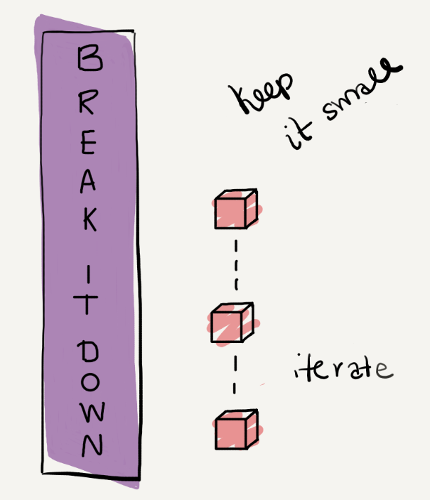
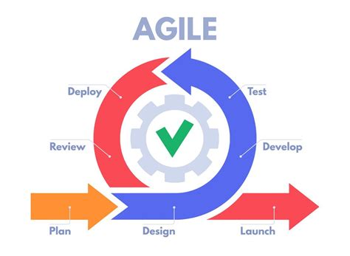
Problem Solving and Software Development
Approach problem solving using Agile Software Development concepts to help you design and implement a solution that is maintainable, testable and extendable.
You will
Design:
Analyze User Stories and Acceptance Criteria (requirements)
Break the problem into smaller tasks or into classes
Create test cases for tasks (methods)
Design Algorithms in Pseudocode for Tasks (Methods)
Develop and Unit Test
Unit test as you implement code
Create quality code
Complete final testing
Reflect and Improve

Slide 4
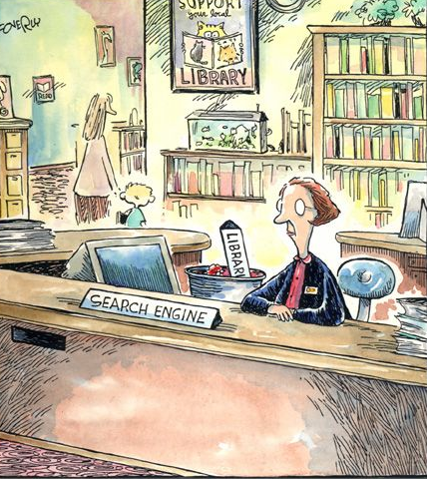
User Stories and Acceptance Criteria
User Stories are what the user needs and acceptance criteria is how we know it works.
A short sentence that describes a feature from the user’s perspective.
Format: As a [type of user], I want [some goal] so that [reason/value].
Example (Library App):
As a librarian, I want to add a book so that it is stored on the shelf.
Acceptance Criteria
A checklist of conditions that define when the story is “done.”
Written as clear, testable statements.
Helps guide both implementation and testing.
Example (for “Add a book”):
If a slot is available, book is placed and message printed.
If library is full, system prints error and does not crash.
Books are always placed in row-major order.

Slide 5
Library App User Stories
Story 1 Represent a Book: As a librarian, I want each book to have its details recorded so that I can identify it on the shelf.
Acceptance Criteria: Each book shows its title, author, and year. When I look up a book, I see its information clearly formatted.
Story 2 Create a Library with Shelves: As a librarian, I want to set up shelves with space for books so that I know how many I can store.
Acceptance Criteria: The library has a name, shelves, and spaces per shelf. If setup is invalid, it still starts safely.
Story 3 Add a Book Automatically: As a librarian, I want to add new books into the next available space so that shelves fill in order.
Acceptance Criteria: When I add a book, I’m told where it was placed. If the library is full, I’m told it cannot be added.
Story 4 Display All Books: As a library member, I want to see what books are available so that I can browse them.
Acceptance Criteria: A table lists each book with its location, title, author, and year. Empty spaces not shown.
Story 5 Count Books Per Shelf: As a librarian, I want to see how many books are on each shelf so that I can track usage.
Acceptance Criteria: A report shows each shelf with the number of books it holds.
Story 6 Find the Oldest Book: As a librarian, I want to know the oldest book in the library so that I can feature it.
Acceptance Criteria: If no books, I’m told it is empty. Otherwise, I see the oldest year and all books from that year
How would you approach this problem? On paper start analyzing and designing a solution.

Slide 6
Analyze Requirements and Design Classes
Design classes around real-world things.
One job per class keeps design clean.
No copy-paste reuse code with methods.
1. Think in Nouns
A class usually represents a thing in your program (Book, Student, Library).
The class holds the data (fields) and the actions (methods) related to that thing
2. SRP – Single Responsibility Principle
“One class, one job.”
Each class should only do one main thing.
Book → stores book details.
Library → manages a collection of books.
If a class tries to do too much, it becomes confusing and hard to test.
3. DRY – Don’t Repeat Yourself
“Write it once, use it everywhere.”
If you see the same code copied in two places, move it into a method or class.
Example: Calculating late fee for an overdue library book
This makes programs shorter, easier to update, and less error-prone.

Slide 7
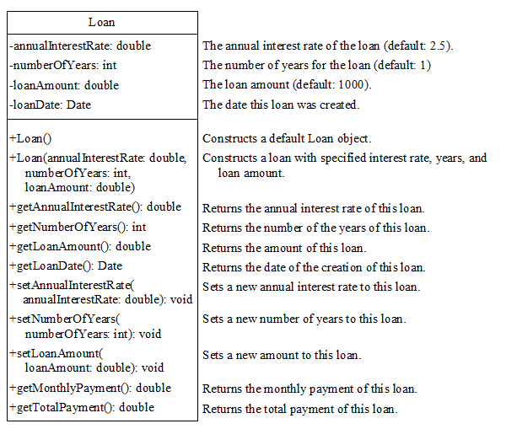
Designing the Loan Class
UML Class Diagram Tutorial:
- means private
+ mean public
Abstract Data Type (ADT): A class is called an abstract data type - the use of the class is separated from the implementation.
When you create a class, you're creating a new data type
Class contract is the signatures of public and private
variables and data types
constructors
methods parameters and return values

Slide 8
Developer View
User Stories focuses on customer experience (“I want to see… I’m told when…”)
Developer now focuses on implementation details (arrays, methods, return values).
Both are needed: one drives requirements, the other guides coding.
Customer View (plain language)
Story 1: Represent a Book As a librarian, I want each book to have its details recorded so that I can identify it on the shelf.
Acceptance Criteria:
Each book shows its title, author, and year. When I look up a book, I see its information clearly formatted.
Developer View (technical detail)
Book class with private fields title, author, year.
Constructor sets fields; getters retrieve values.
toString() formats "Title" by Author (Year).

Slide 9
Design Classes
Book
UML CLass Diagram Design
SRP: Each class has ONE job
Book handles details, Library handles management.
DRY: Don’t Repeat Yourself
Put shared logic in one place (e.g., Book.toString()).
Refer back to library app user stories and approach from a developer view
Library
What classes, data members, constructors and methods are needed?

Slide 10
Book Class Design
Story 1 Represent a Book: As a librarian, I want each book to have its details recorded so that I can identify it on the shelf.
Acceptance Criteria: Each book shows its title, author, and year. When I look up a book, I see its information clearly formatted.
Developer View
Book class with
private fields title, author, year
Constructor sets fields
getters retrieve values
toString() formats "Title" by Author (Year)
Book (Follows encapsulation)
- title: String - author: String - year: int
+ Book(String:title, String:author, int:year) + getTitle(): String + getAuthor(): String + getYear(): int + stringOfBookDetails(): String
Constructor doesn’t have return value

Slide 11
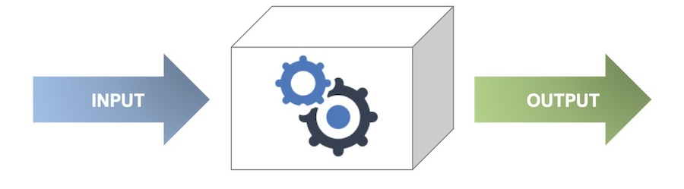
Implement and Unit Test one Class
What is Unit Testing? Unit testing means testing one small piece of code (a “unit”) on its own.
In Java, a “unit” is usually a single method or a single class.
Catch problems early before they spread.
Prove each class works by itself before combining into bigger systems.
Makes it easier to change or extend code later (confidence).
Write small test code in main that:
Creates objects with known data.
Calls each constructor and method.
Prints results and compares to expected.
Check: Did the actual output match what you expected?
constructor
method
preconditions
postconditions
Book book1 = new Book("Unmasking AI", "Joy Buolamwini", 2023);
// Expected: "Unmasking AI"
System.out.println("getTitle(): " + book1.getTitle());
// Expected: "Joy Buolamwini"
System.out.println("getAuthor(): " + book1.getAuthor());
// Expected: 2023
System.out.println("getYear(): " + book1.getYear());
// Expected: "Unmasking AI" by Joy Buolamwini (2023)
System.out.println("toString(): " + book1.toString());
getTitle(): Unmasking AI
getAuthor(): Joy Buolamwini
getYear(): 2023
toString(): "Unmasking AI" by Joy Buolamwini (2023)

Slide 12
Library Class Design
Library (Follows encapsulation)
- name: String - bookShelf: Book[][] - numberOfShelves: int - shelfCapacity: int - currentShelf: int - currentSlot: int - isFull: boolean
+ Library(name:title, shelves:int, shelfCapacity:int) + getName(): String + addBook(book:Book): boolean + printAllBooks(): void + printOldest(): void + countPerShelf(): int - countBooks() : int
Developer View
Library class with
Library class with field Book[][] grid.
Constructor takes rows and cols;
defaults to 1×1 if invalid.
Method addBook(Book) scans row-major order.
On success prints confirmation, returns true.
If full, prints message and returns false.
Method printAll() loops through Book[][].
Prints formatted table of non-null entries.
Method printOldest
Prints oldest book(s). If no books, prints "Library is empty." and returns.
Private Helper Method countPerShelf() return the number of books on each shelf
How will you implement constructor?

Slide 13
Constructor
public Library(String name, int shelves, int shelfCapacity)
{
if (name == null || name.isEmpty()){
this.name = "Library";
} else{
this.name = name;
}
if (shelves <= 0 || shelfCapacity <= 0){
this.numberOfShelves = 1;
this.shelfCapacity = 1;
} else{
this.numberOfShelves = shelves;
this.shelfCapacity = shelfCapacity;
}
this.totalBookCapacity = numberOfShelves * shelfCapacity;
this.bookShelf = new Book[numberOfShelves][shelfCapacity];
this.currentTotalBooks = 0;
this.currentShelf = 0;
this.currentSlot = 0;
this.isFull = false;
}
Notice the constructor is checking for invalid data
If invalid data sets array default to [1][1]

Slide 14
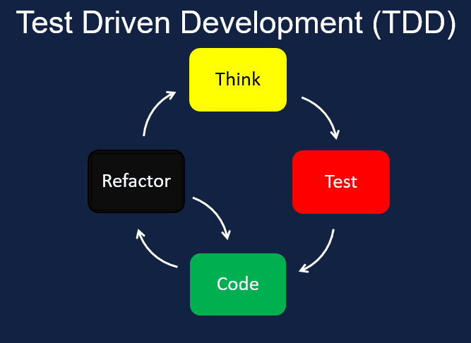
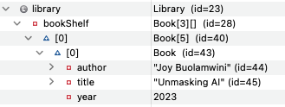
Use Test Driven Development
When designing more complex algorithms it is helpful to use test driven development to design algorithm
Test Driven Development (TDD)
Write test cases first
Write Code just enough to pass the first test.
Run it, compare output to your test case output
Add the next test, update code, and tidy/refactor.
Repeat.
precondition | Action | Expected Result (post condition)
T1: Library has 1 shelf with 2 slots Library library = new Library("Library Test", 1, 2); | Add Book Unmasking AI, Joy Buolamwini, 2023 library.addBook(new Book("Unmasking AI", "Joy Buolamwini", 2023)); | Displays: Added at shelf 1, slot 1 Use debugger 2D Array slot filled at [0][0]
Add more test cases

Slide 15
Use Test Driven Development
Display All Books: As a library member, I want to see what books are available so that I can browse them.
Acceptance Criteria: A table lists each book with its location, title, author, and year. Empty spaces not shown.
How do you know if a library slot is empty?
precondition Library Has | Action | Expected Result (post condition
T1: 1 shelf with 2 slots | Add Book Unmasking AI, Joy Buolamwini, 2023 | Displays: Added at shelf 1, slot 1 2D Array slot filled at [0][0]
T2: 1 shelf 1 of 2 slots filled. | Add Clean Code, Robert C. Martin, 2008 | Displays: Added at shelf 1, slot 1 Use debugger: 2D Array slot filled at [0][1]
T3: 1 shelf 2 of 2 slots filled. | Add Refactoring, Martin Fowler, 1999 | Displays: Library is full. Couldn't add "Refactoring" by Martin Fowler (1999) Use debugger: 2D Array no change
T4: 1 shelf 2 of 2 slots filled. | Add invalid book library.addBook(null); | Displays: Invalid Book Use debugger: 2D Array no change

Slide 16


Design Algorithms
If library has space → book added at correct shelf/slot.
If library is full → print message, return false.
If book is null → print message, return false.
precondition Library Has | Action | Expected Result (post condition | Implement a little code to pass one test.
T1: 1 shelf with 2 slots | Add Book Unmasking AI, Joy Buolamwini, 2023 | Displays: Added at shelf 1, slot 1 2D Array slot filled at [0][0] | bookShelf[currentShelf][currentSlot] = book;
T2: 1 shelf 1 of 2 slots filled. | Add Clean Code, Robert C. Martin, 2008 | Displays: Added at shelf 1, slot 1 Use debugger: 2D Array slot filled at [0][1] | bookShelf[currentShelf][currentSlot] = book;
T3: 1 shelf 2 of 2 slots filled. | Add Refactoring, Martin Fowler, 1999 | Displays: Library is full. Couldn't add "Refactoring" by Martin Fowler (1999) Use debugger: 2D Array no change | if (isFull)
T4: 1 shelf 2 of 2 slots filled. | Add invalid book | Displays: Invalid Book Use debugger: 2D Array no change | if (book == null)

Slide 17
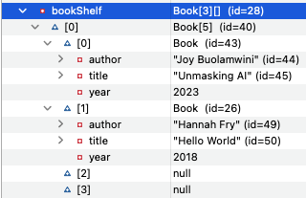
Refactored
public boolean addBook(Book book) {
if (book == null){
System.out.println("Invalid book.");
return false;
}
if (isFull){
System.out.println("Library is full. Couldn't add " + book.stringOfBookDetails());
return false;
}
bookShelf[currentShelf][currentSlot] = book;
System.out.println("Added " + book.stringOfBookDetails() + " at shelf " + (currentShelf + 1) + ", slot "
+ (currentSlot + 1));
currentTotalBooks = currentTotalBooks + 1;
if (currentTotalBooks >= totalBookCapacity){
isFull = true;
} else{
int nextIndex = currentTotalBooks;
currentShelf = nextIndex / shelfCapacity;
currentSlot = nextIndex % shelfCapacity;
}
return true;
}
Check should go first for invalid book
Return if can’t place book
check to see if full
Return if can’t place book
addBook method has a single purpose There are only a few distinct outcomes:
1. Invalid input: book == null.
We can’t continue, so we stop right away (return false).
2. No empty slot available
The library is full, so there’s no point in continuing; return immediately (return false).
3. Success: found an empty slot.
Place the book, print a confirmation, return true.
Each of these conditions is self-contained.
Using early returns here keeps the method simple and readable.
Return that book was placed

Slide 18
Quality Software Practices
Quality software is clear, maintainable, testable code.
Performance means avoid wasted work
Our rules are about clarity and predictability:
✅ Use multiple returns & early returns for clarity.
❌ Avoid infinite loops, System.exit(), break, and continue for maintainability.
✅ Multiple & Early Returns
Use early returns for simple guard checks that fail fast (invalid input, full array, null values).
Example: In addBook, return immediately if the book is null or the library is full.
Avoid them if the method is long, has complex state to manage, or requires cleanup code. They can cause problems if:
A method is very long and has many different return points → it becomes hard to see all the ways out.
Consistency matters — for example, in constructors you often want one exit point at the end for clarity.
🚫 No Infinite Loops
Why: A loop without an end condition can freeze your program.
Quality impact: Users can’t trust the software if it hangs.
Performance impact: Wastes CPU cycles and memory.
🚫 No break or continue
Why: These jump out of the middle of a loop and make code harder to follow.
Quality impact: Future readers (including you!) may miss hidden exits.
Alternative: Use clear conditions (if checks, early returns) to control flow.

Slide 19
To Early Return or Not
Better approach: One return at the end
Here we gather results into a variable and ensure cleanup happens before returning.
public String readFirstLine(String fileName) {
try {
Scanner in = new Scanner(new File(fileName));
if (!in.hasNextLine()) {
return null; // EARLY RETURN 1
}
String line = in.nextLine();
if (line.isEmpty()) {
return null; // EARLY RETURN 2
}
return line; // EARLY RETURN 3
} catch (FileNotFoundException e) {
return null; // EARLY RETURN 4
}
}
public String readFirstLine(String fileName) {
String result = null; // default if nothing works
Scanner in = null;
try {
in = new Scanner(new File(fileName));
if (in.hasNextLine()) {
String line = in.nextLine();
if (!line.isEmpty()) {
result = line;
}
}
} catch (FileNotFoundException e) {
result = null;
} finally {
if (in != null) {
in.close(); // always runs
}
}
return result; // single exit point
}
Problem:
There are four different return paths scattered across the method.
Easy to miss cleanup: the Scanner is never closed if an early return happens!
Harder to read, because you have to scan the whole method to see all the exits.

Slide 20
Implementing Code Guide for this Class
Why? Read Code Conventions for the Java Programming Language: 1. Introduction
We will follow the following when implementing code
Naming Conventions - Java
Braces are used with if, else, for, do and while statements, even when the body is empty or contains only a single statement.
One declaration per line since it encourages commenting
Put declarations only at the beginning of blocks.
Do not use ternary operator for this class. While the ternary operator is useful for simple conditions, it can make code harder to read if overused or used with complex logic. In such cases, traditional if-else statements may be clearer
// Use this
String resolvedName;
if (name == null || name.isEmpty()) {
resolvedName = "Library";
} else {
resolvedName = name;
}
// do not use
String resolvedName = (name == null || name.isEmpty()) ? "Library" : name;

Slide 21
Code Design and Layout
public class ClassDriverTestClass
{
public static void main(String[] args)
{
}//end main
public static void method()
{
}//end method
}//end class
class ClassName {
private double instanceVar1;
/** Constructor
public ClassName() {
}
/** Overload Constructor*/
public ClassName(double newinstanceVar1) {
instanceVar1 = newinstanceVar1;
}
/** class method*/
double method1() {
return instanceVar1;
}
}// end className
ADD MORE CLASSES
When implementing remember
Software Design Principles Don’t Repeat Yourself (DRY) and Keep It Simple Silly (KISS)
Single Responsibility Principle (SRP)
You will put all code information in one file. When you define a public class in a Java file it must match the file name.
Put driver class with main method first. This class is accessible by other classes, and it acts as the main entry point for your program if it contains the main method. Java allows only one public class per file to maintain a clear, organized structure.
Follow with user defined class and they are not marked as public, which means it has package-private access by default. This class to be used only by ClassDriverTestClass
variables (implement encapsulation)
constructor
methods
We will not be utilizing packages or separate files for your user defined classes.

Slide 22
Avoid Hardcoding
Avoid hard coding data
Hard-coded numbers also called “magic numbers.”
They make code hard to read, hard to update, and easy to break.
if (booksOnShelf > 5) { // Why 5?
System.out.println("Shelf full!");
}
If shelf size changes to 10, you must hunt down every 5 and update it.
Easy to miss one, causing bugs.
Instead, use constants, variables, or parameters so your code is clear, maintainable, and adaptable.
private static final int MAX_SHELF_CAPACITY = 5;
if (booksOnShelf > MAX_SHELF_CAPACITY) { ... }

Slide 23
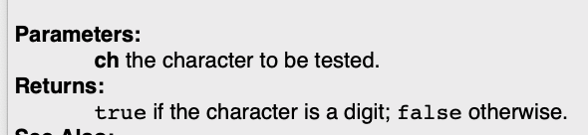
Readable Documented Code
Notice how the built in methods contain comments
Documenting code with comments.
Initial comment above code
JavaDoc comments above methods
// single line comments for complex code
You can Generate JavaDoc Comments for methods and classes and then edit
Initial comment at top of source file should include name, class and description of what program does.
Comments above method you create should contain summary of what method does and describe the parameters and return value
/**
* Library App Test Driver
* Contains Book and Library Classes to be tested
* 1) Set up library
* 2) Add up to capacity
* 3) Print table of books
* 4) Print count per
* 5) Print oldest book(s)
*
*/
/**
* Constructs a library with the given name and shelf dimensions.
* If dimensions are invalid default of 1x1 is used.
* @param name library name
* @param shelves number of shelves (rows)
* @param shelfCapacity number of slots per shelf (columns)
*/
public Library(String name, int shelves, int shelfCapacity)

Slide 24
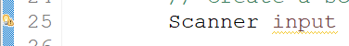
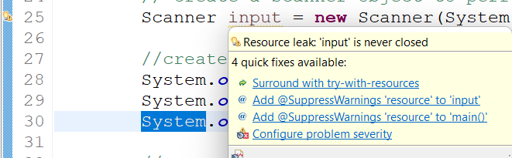
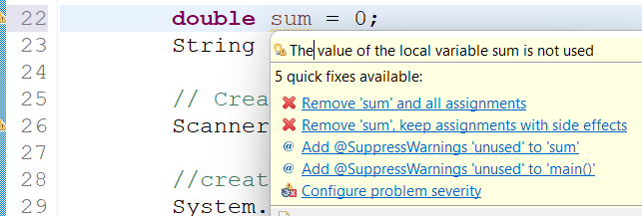
Eliminate Warnings
Warnings are given to improve the quality of your code.
Look for the warnings and the message of suggestions on how to fix.
Use what you have learned in class to fix. Get help if you aren’t sure how to fix it.

Slide 25


Learnings and Reflection
What is a Retrospective? Reflect after an iteration to improve on the next.
In industry we would celebrate successes, discuss lessons learned, and any necessary changes to improve.
Reflecting and documenting learnings is a valuable process, so you can improve.

Slide 26
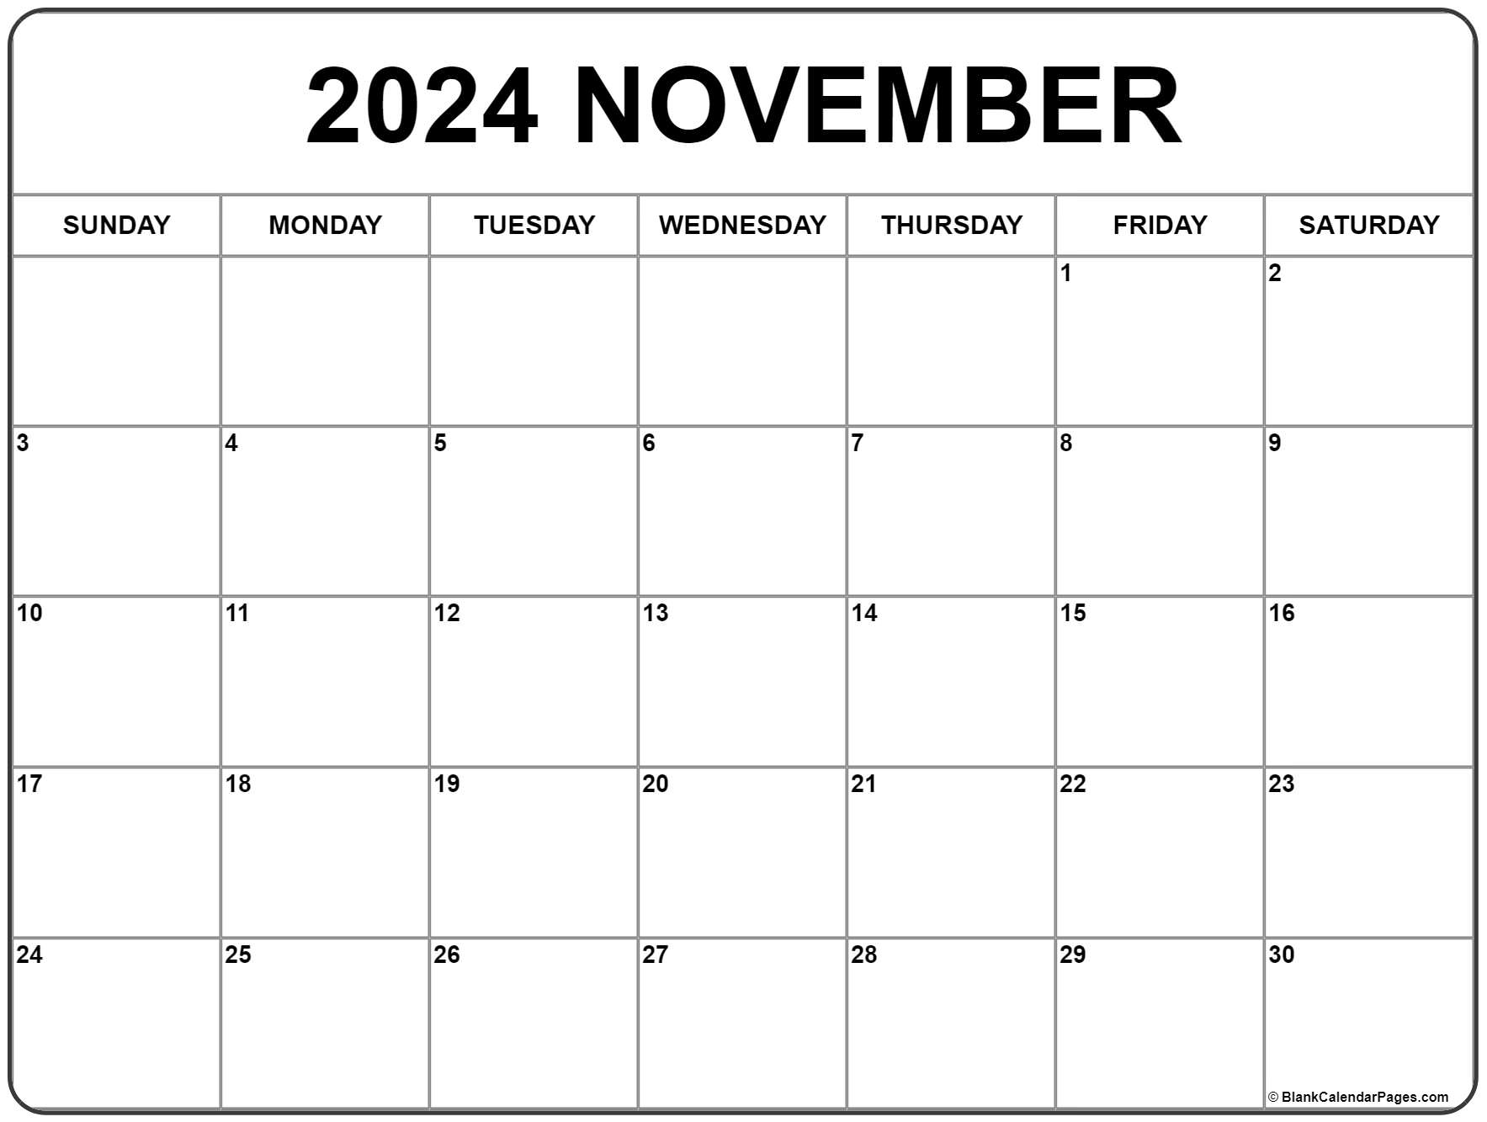
Plan Your Time
Look at your tasks and plan dates you will work on each task - Project Planning
List tasks to code and unit test
List Tasks to code and unit test
Finish coding and testing
Finish coding and testing
Review assignment details and if complete submit
DUE!
What you can do using project planning on GitHub - DEV Community

